Slide 1

Weekly news
Keresztúri Péter
Github: Plonee

Slide 2
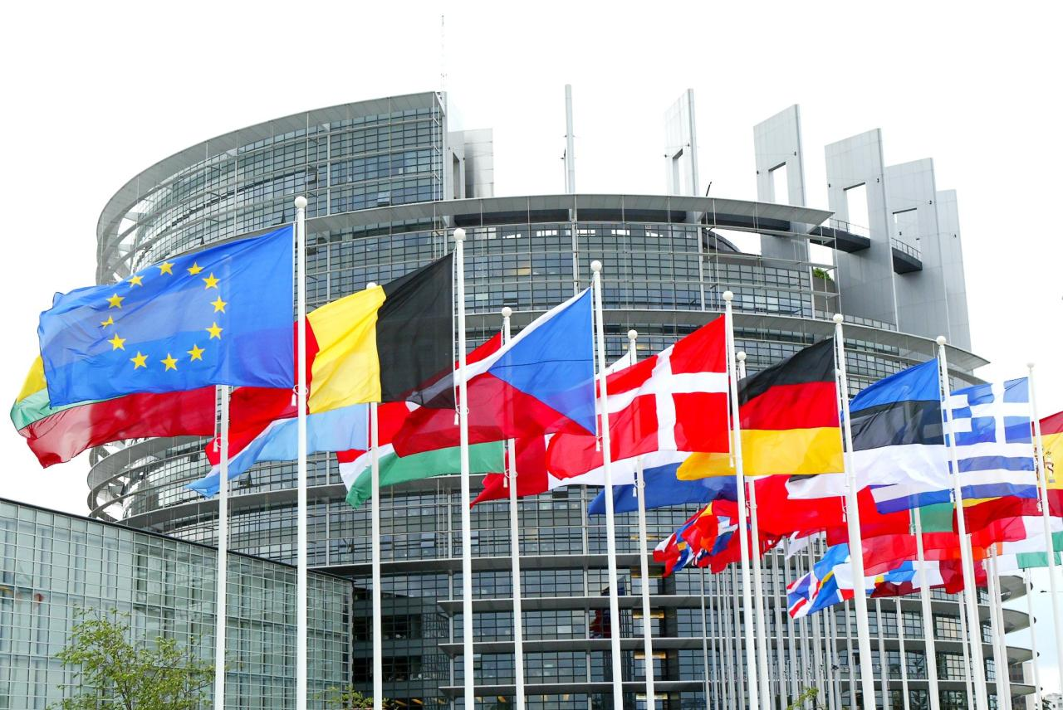
International Politics

Slide 3
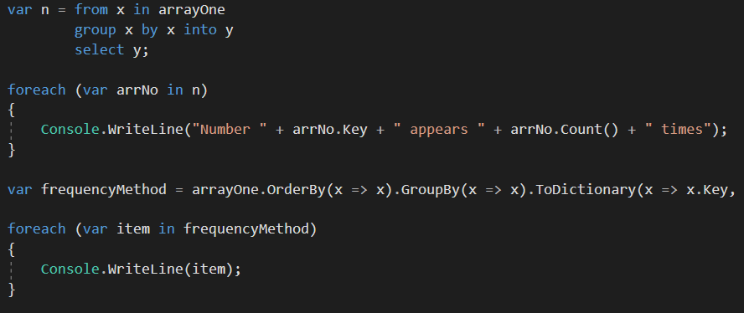
European Parliament accepted a referendum about LINQ

Slide 4

Crime

Slide 5
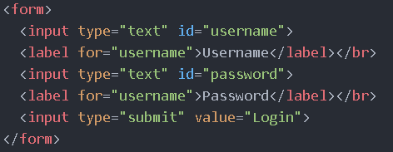
Two hospitalized after failed HTML attempt

Slide 6
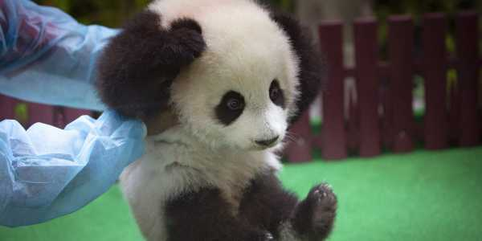
Other news: baby panda born in Nyíregyháza Zoo

Slide 7
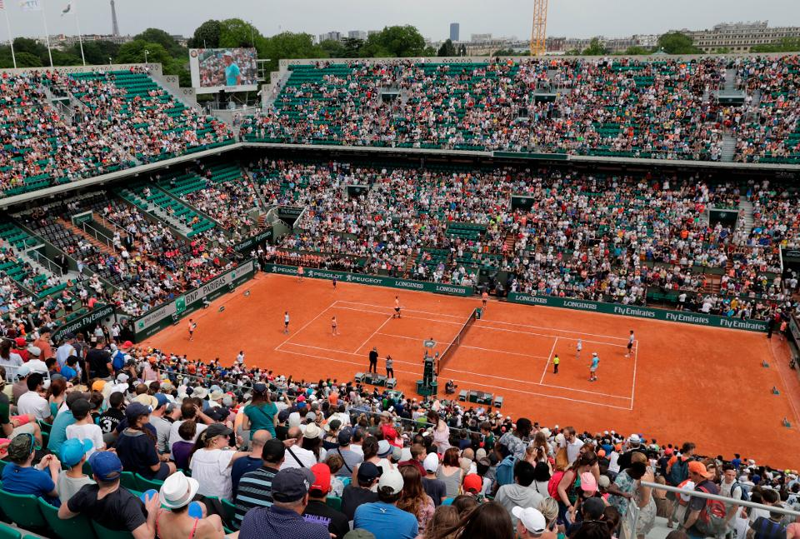
Sports

Slide 8
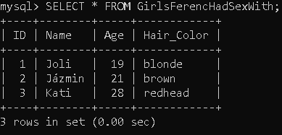

Pete won the SQL cup, helped by trainer Laci and Niki

Slide 9
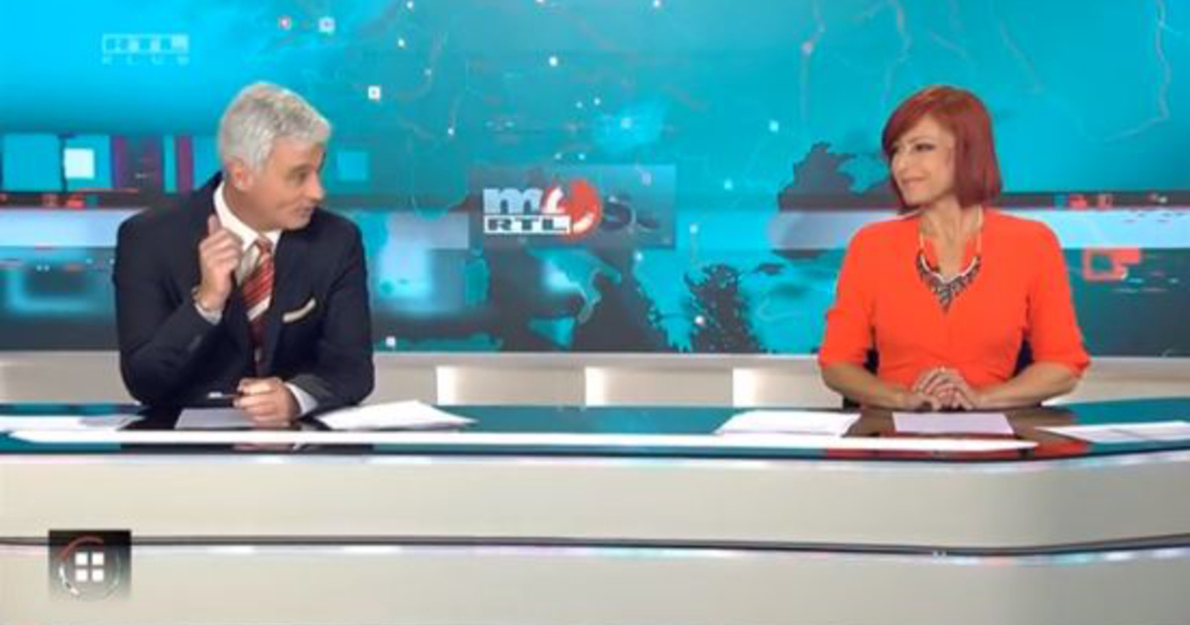
Thank you for your attention

